Slide 1

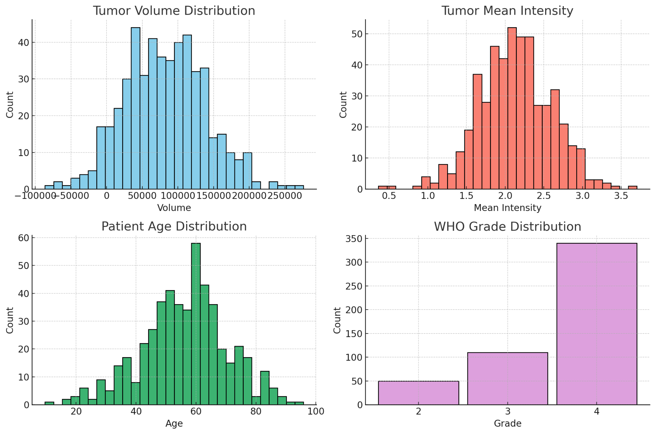
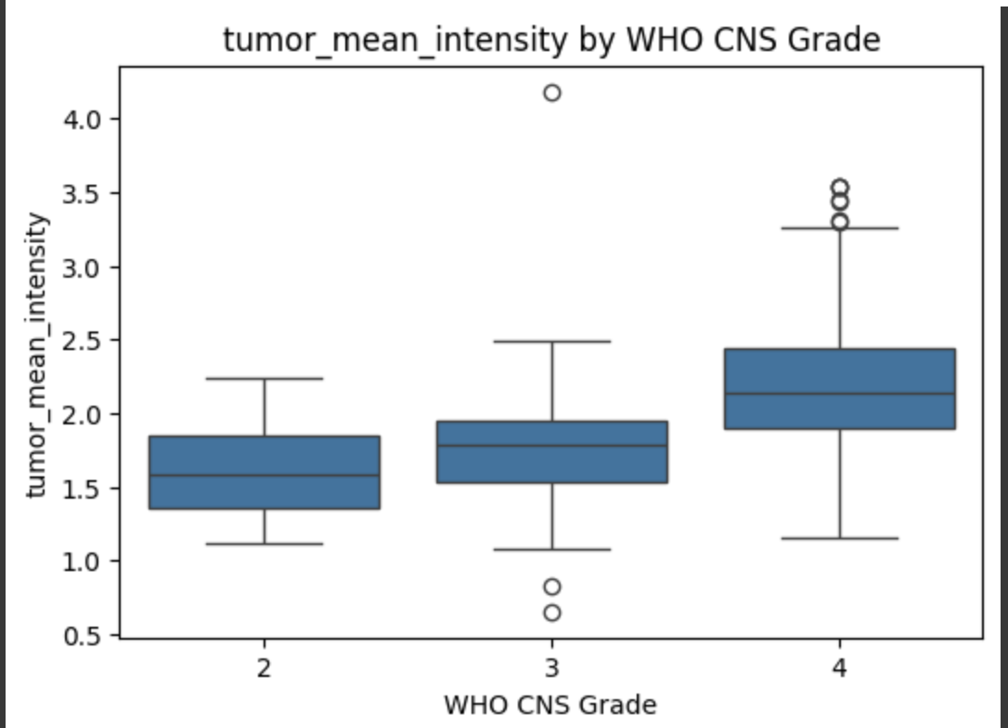
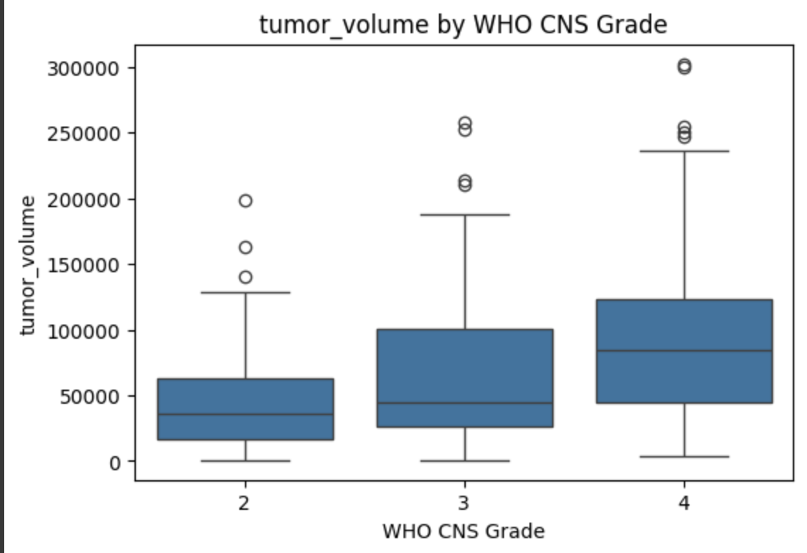
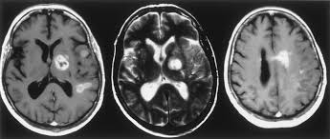
Machine Learning Approaches to MRI-Based Glioblastoma Prognosis
Contributors: Maxine Baghdadi, Arpit Dang, Xiaoke Song, Yitong Wang Professor: Dr. Jay Hou
INTRODUCTION
METHODS
OVERVIEW
This project aims to predict glioma grade by building a machine learning pipeline that leverages both MRI slices and clinical metadata. Using the UCSF Preoperative Diffuse Glioma MRI (UCSF-PDGM) dataset, we extracted 2D tumor-containing slices from 3D T1 post-contrast (T1c) MRIs using expert-annotated segmentation masks. We paired these with patient-level clinical and molecular data — including age, sex, and IDH/MGMT status — to train models that predict the WHO CNS tumor grade.
MOTIVATION
Glioblastoma is the most common form of brain cancer in adults and remains one of the deadliest of human cancers (Stupp et al. 2009; Cai and Sughrue 2018). Survival beyond two years is rare, and therapeutic options limited. Conventional structural magnetic resonance imaging (MRI) is the standard of care imaging method for neuro-oncologic practice. However, the fundamental understanding of tumor progression and patient survival as a function of MRI data remains unclear.
DATASET
For this project, we used the UCSF Preoperative Diffuse Glioma MRI (UCSF-PDGM) dataset, which is publicly available from the Cancer Imaging Archive (TCIA) that includes multi-parametric MRI scans and clinical metadata for ~ 500 patients with diffuse glioma. After filtering, we ended with 360 patients that with complete clinical metadata and valid MRI scans
MRI Data:
~ 900 axial T1 post-contrast (T1c) slices containing tumor regions
For each patient, we extracted 2-3 axial slices centered on the tumor
Z-score normalized and resize to 128x128
Clinical Metadata:
Demographics: Age at MRI, Sex
Molecular markers: MGMT status/index, IDH mutation, 1p/129q codelation
Outcomes: WHO CNS Grade (used as prediction target)
INITIAL EDA
TRAINING AND EVALUATION
Training Loop: Adam optimizer & Cross-Entropy Loss, a standard approach for multi-class classification
Early Stopping: To prevent overfitting, the models are trained with an early stopping mechanism that saves the best model based on a combined score of validation accuracy and F1 score
Metrics: accuracy & macro-averaged F1 score
RESULTS
The higher F1 score for AlexNet suggests that the model was more effective at
correctly identifying positive instances of each WHO grade (precision)
capturing all relevant instances of each grade (recall)
The image-based models are better at capturing the features needed to distinguish between WHO grades
For each model, we calculated the accuracy and F1 score and the results can be seen below:
 | AlexNet | Multimodal AlexNet
Test Accuracy | 89.00% | 88.67%
Test F1 score (macro) | 0.7811 | 0.5538
PREPROCESSING
Image (MRI)
Normalization: The T1c MRI images are normalized using a z-score method, subtracting the mean and dividing by the standard deviation
Slice Extraction: Instead of processing the entire 3D MRI, the project extracts 2-3 central 2D slices that contain tumor tissue from each patient's data
Cropping and Resizing: Each 2D slice is center-cropped or padded to a target size of 128x128 pixels and then resized to 224x224 pixels to match the expected input size of the AlexNet architecture to ensure consistency across the dataset
Clinical Metadata
Categorical One Hot Encoding
Imputation: Missing values in columns like OS (Overall Survival) are imputed using the mode or median of the respective columns
Standardization: Numerical features are standardized to have a mean of 0 and a standard deviation of 1
KEY FINDINGS
AlexNet alone performed best, suggesting strong signal in MRI features
Fusion model underperformed due to low or noisy signal in metadata
WHO Grade 4 was the most common class, leading to slight class imbalance
NEXT STEPS
Improving metadata feature engineering to reduce noise
Expanding the dataset with more patient data to validate the current findings
Incorporating additional modalities like FLAIR or T2
Exploring LLM e.g., QWEN
MODELS
To evaluate whether tumor imaging and clinical features can predict glioma grade, we trained supervised learning models on MRI slices, metadata, and their combination. This allowed us to compare the predictive power of visual patterns in tumor appearance against structured patient-level information.
AlexNet | AlexNet + Multi-Layer Perceptron
Trained on 2D axial T1c MRI slices For each patient, extracted 2-3 central tumor-containing slices Images z-score normalized and resized to 128x128 Input: grayscale (1 channel); Output: 4-class classification (WHO grade) | MLP trained on patient metadata (Age, Sex, MGMT, IDH, 1p/19q, OS) AlexNet used for feature extraction from images Final fusion layer concatenated both image + metadata embeddings to predict WHO grade
CONTRIBUTIONS
Proposal: All
Download & Upload the Dataset: Arpit & Maxine
Import & EDA: Arpit & Maxine
Data preprocessing: Arpit & Maxine
Create model & train: Xiaoke & Yitong
Results & Final poster: All
Notes:
EDA
Age: normal distribution with the mean/mode is around 60 years old
Most patients had a higher Grade cancer of 4. None were Grade 1, and the majority were Grade 4 (more than Grade 2 and 3 combined).
Here is an example of mean tumour intensity, normal distribution with mode of about 2.0 units
Grade 4 patients tend to have a higher median Tumour Mean Intensity, compared to Grade 2 and 3 patients.
About 60% were males, and 40% were females
Data Preprocessing
We checked for valid patients; ensured that both files exist within the dataset. We found 500 valid patients in terms of their MRI images.
For each T1c MRI, we normalized it using a z-score method, which subtracts the mean and divides it by the SD.
We do that so it brings all images into a comparable scale, making training more stable.
Z-score is preferred because it standardizes per patient and highlights relative differences in tissue contrast.
We used 2 - 3 2D slices instead of 3D.
Reduces computational cost, and it focuses on the informative regions.
Learns the features directly with limited background noise
We crop it to 128x128 to ensure that the tumor region is centrally located and all slices have the same dimensions.
We re-size it to 224x224which is a common AlexNet input for CNNs
Clinical Metadata
One Hot Encoding for Categorical data
For Categorical data, we made an ‘unknown’ column for missing data
StandardScalar: For continuous data.
We either replaced it with mean or mode of the respective columns
We used this, because it keeps the range small compared to to MinMax Scalar

